Slide 1
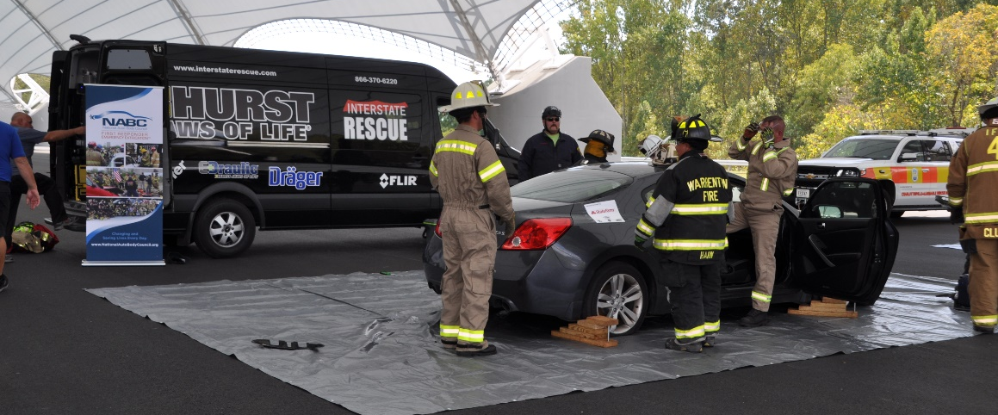
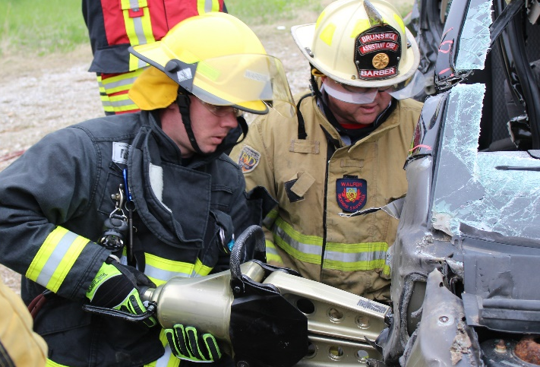
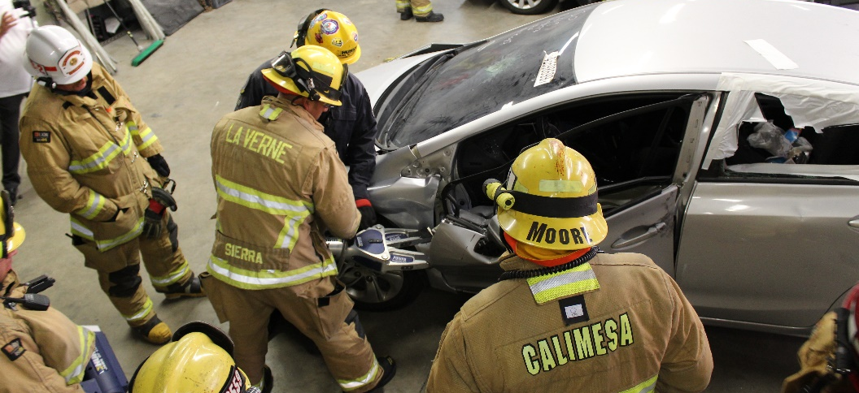
NABC™ F.R.E.E.™
George Avery, Greg Brown and
Michael Jordan

Slide 2
NABC™ F.R.E.E.™
NABC Mission Statement: To develop, implement and promote community-based initiatives that exemplify the professionalism and integrity of the collision repair industry.
Committee Chair(s):
Michael Jordan
Greg Brown
Committee Members:
Jeff Wildman
Randy Wittig
Bill Mayer
Jeff Del Rosso
Committee Mission: To implement the NABC™ F.R.E.E.™ program which affords NABC members the opportunity to promote a community-based initiative that exemplifies the professionalism and integrity of the collision repair industry in their community.

Slide 3
2019 Goals and Priorities
2019 Goal(s):
Develop and implement NABC™ F.R.E.E.™ event processes/procedures that is efficient for members hosting events and results in 50 F.R.E.E. events in 2019.
Priorities & Goals:
F.R.E.E. Committee (Committee driven improvement is required)
Grow committee members (regional format)
Equip all committee members, rescue tool providers, and First Responders to sell and promote NABC membership
Start working on F.R.E.E. specific committee task management
Regional supported by committee members?
Reach our goal of 50 F.R.E.E. events in 2019.
Create monthly statistics reporting to monitor:
progress towards the goal of 50 events in 2019
analyze past events successes
identify areas of improvement
Special events
S.W.I.M. Presentation
LKQ Corporation/ Toyota
SALSA
Orientation call
Maintain Live Orientation Call
Online versions
Standard approved Flyer
Challenge Coins, Decals/Wrap and Signage

Slide 4
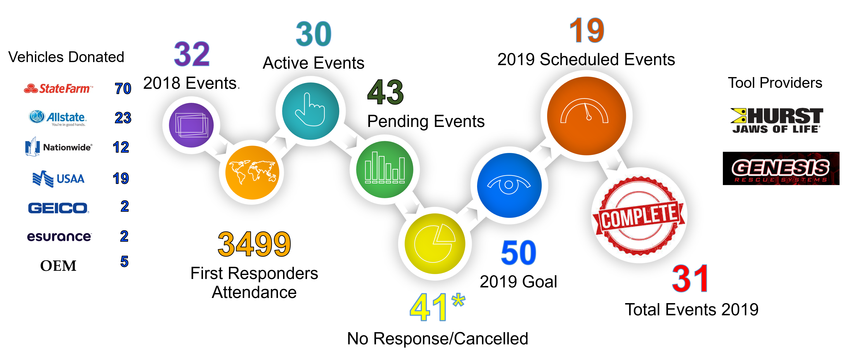
2019 Results

Slide 5
Key Initiatives and Needs
Key Initiatives
Tier 1: Sales Package for First Responders
Tier 2: Flyer Template
Tier 3: Update Orientation process (live and on-line)
Tools Being Used:
Online tool (limited input capability for the F.R.E.E.™ event)
Excel spreadsheet developed and maintained by George Avery
Tools Needed:
Online tool to replace standalone Excel spreadsheet.
Greatest Need:
Committee members (includes HURST and Genesis Instructors)
Greatest Challenge:
Get more people to buy in to NABC:
Lack of a clear understanding of the NABC value proposition
When asked about membership and cost to join, committees are not equipped to sell NABC membership

